Slide 1

Mini-project midterm report- Problem A: Etcembly Ltd
Group 4 : shalomi FERNANDES; Fangnan Wei; Jiadong xu; Jiahui liu

Slide 2
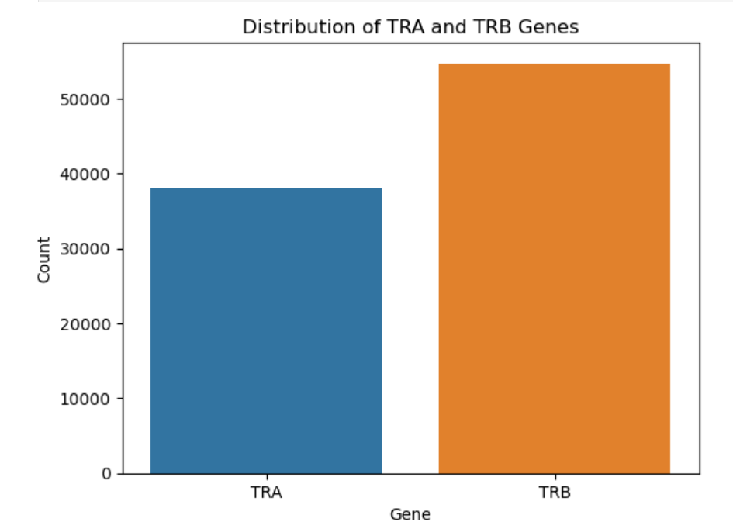
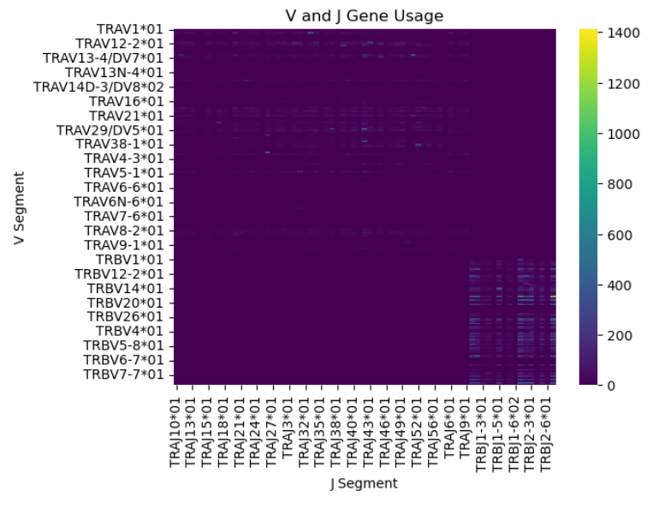
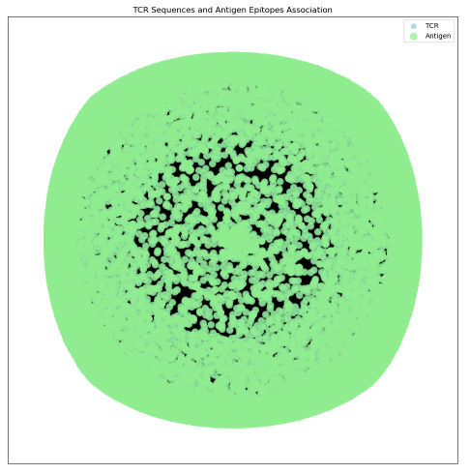
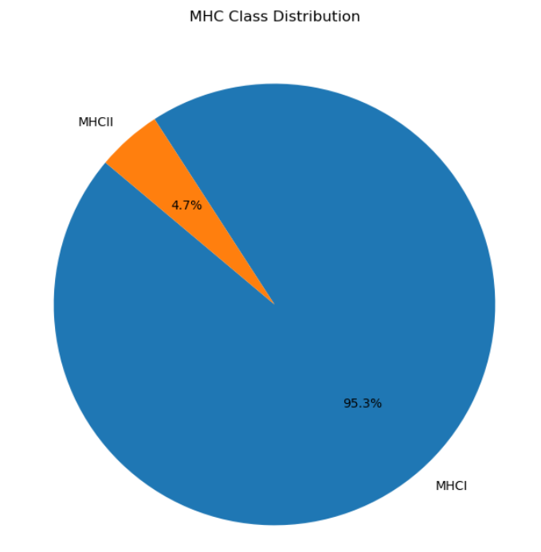
Understanding of the problem（Tasks 1): what is INPUT and OUTPUT ：input is cdr3、v、j；output is epitope what columns we need: cdr3、v、j、 epitope; We are struggling with whether we need species and mhc.
Data sources : VDJdb https://vdjdb.cdr3.net/search
Data summary : From the graphs, we can see that TRB is more than TRA; MHCI accounts for the vast majority, at 95.3%; The heatmap shows the correlation between the V vs J gene usage and the network graph shows the association between the Antigen Epitopes w.r.t the TCR’s.

Slide 3
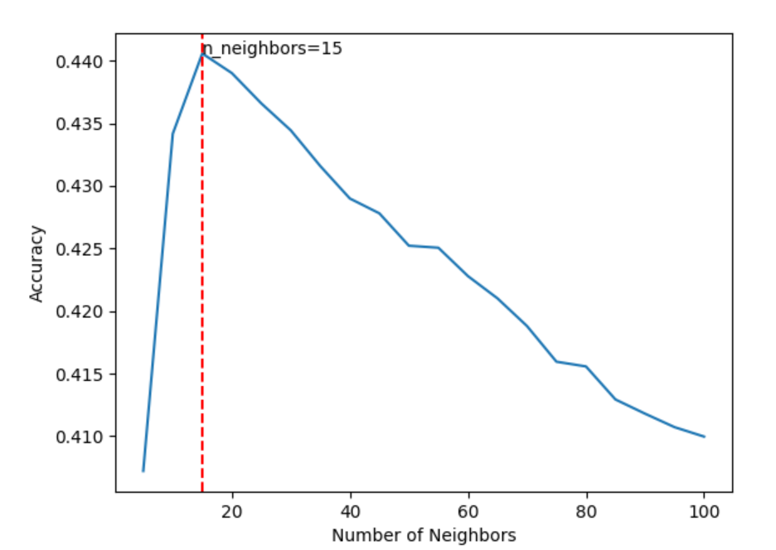
We Try to use K nearest neighbor(knn) for classification.
What is KNN? Why should we use KNN?
KNN relies on the distance measure in the feature space. If KNN can achieve good performance,
it means that the feature can represent the data point well.
What results we get by using KNN:
For KNN, n-neighbors=15 is the best result, accuracy = 0.4406, This result is good. Considering that there are more than a thousand epitopes, this accuracy indicates that cdr3 encoding can represent the TCR well; we use accuracy as a baseline and as a reference for subsequent methods.

Slide 4
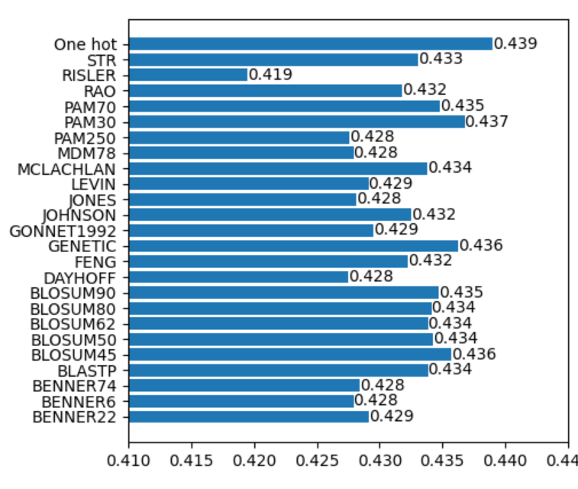
We Base on biological matrices and one-hot for encoding and comparison of knn accuracy, and we found that one-hot has the best effect.
We hope to compare the performance of different encoding methods in KNN and compare which method has higher accuracy.
Because one-hot has the highest accuracy, we decided to use one-hot as the encoding method to complete the calculation of the distance matrix and the classification, dimensionality reduction, and clustering of TCR.
We need to explore other methods such as TCRdist, GLIPH, GIANA, etc.

Slide 5
Things to focus on next and difficulties:
Things to focus on next:
We are exploring more encoding methods for V and J, and better classification methods for TCR.
We may need a better way to calculate distance combining V, J and CDR3.
We decided to try to use TCRDist to calculate the distance matrix first.
Difficulties:
When solving Task 3, we have 90,000+ pieces of cdr3 data. The large amount of data will occupy a lot of memory when calculating the distance matrix, resulting in too long calculation time.
By treating alpha and beta chains combined in the same way as single chains, we worry about losing information during the clustering and classification process.

Slide 6

Thanks

